Slide 1




HACK MATRIX
TEAM HIMALAYA
Team Members Names :
1. Prithviraj More PCCOE
2. Vedant Hirekar DYPCOE
3. Pratham Powar VIT
4. Arnav Tatewar DYPIT
College Name :

Slide 2
Abstract
Tech Stack
Addressed Problem -
Insufficient financial awareness leads to inadequate savings and limited security. Which necessitates solutions to enhance financial literacy and promote savings habits for improved financial well-being.
Why is it crucial to solve this problem?
Solving this problem is crucial as it empowers individuals to make informed financial decisions, leading to greater financial stability and security, ultimately improving overall well-being and resilience against economic uncertainties.
Python
Streamlit
SQLite
NLTK
SK – Learn
Pandas
MatplotLib
All in one app, which is unified and has integrated Backend and Frontend.

Slide 3
Machine Learning Integration
Utilization of NLP for Speech-to-Text Conversion: Employing Natural Language Processing (NLP) techniques to seamlessly transcribe user voice recordings into text format, enhancing accessibility and usability of audio data.
Application of ARIMA for Expenditure Pattern Forecasting: Leveraging the ARIMA model to analyze historical expenditure data and predict future spending patterns, facilitating proactive financial planning and decision-making.
Employment of Random Forest Regression for Mutual Fund Yield Prediction: Implementation of Random Forest Regression algorithm to analyze various factors and historical performance data, enabling accurate prediction of mutual fund yields over different investment horizons.

Slide 4
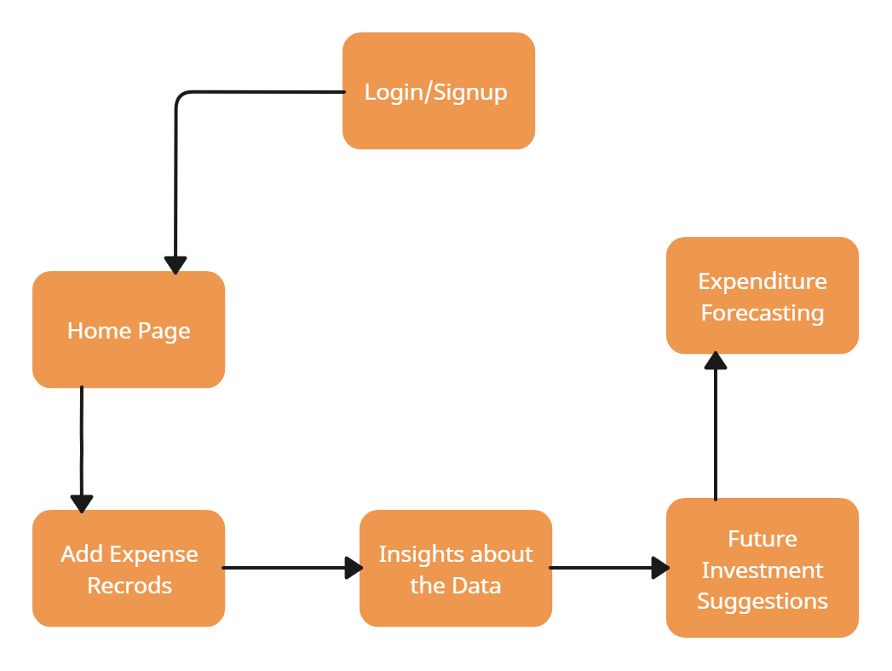
Solution Flowchart

Slide 5
Social Impacts
Show Stoppers
By enhancing financial literacy and promoting savings habits, individuals gain a sense of empowerment and control over their financial futures
Improved financial awareness and savings act as a safety net, shielding individuals from financial crises and unexpected expenses.
Accessible financial education promotes upward social mobility by providing the tools for individuals to build wealth and achieve their aspirations.
Our solution stands out with these key features:
Effortless Transaction Input: Users can easily input transactions via voice recordings, ensuring a seamless experience without the need for manual entry.
AI-Driven Mutual Fund Analysis: Our AI model provides concise insights into emerging mutual fund returns, aiding users in making informed investment decisions.
Future Expenditure Projection: Users gain visibility into anticipated future expenditures, facilitating effective budget planning and financial management.

